Slide 1
Impedance Control Cable-Driven Gripper
James Quek
Meet Nandu

Slide 2
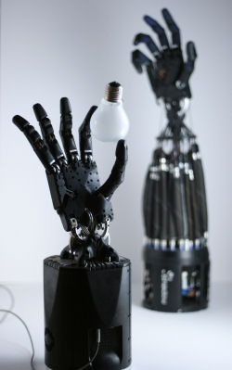

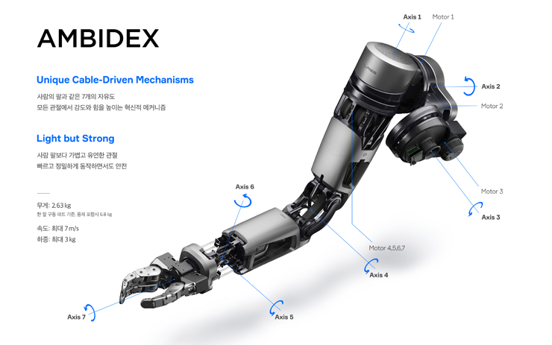
Purpose
Robotic applications increasingly trend towards closer interaction with humans, thus there is a desire for implementing high force, impedance-controllable end-effectors using cable transmission
Worth exploring nuances of robotic impedance control for cable-driven systems

Slide 3
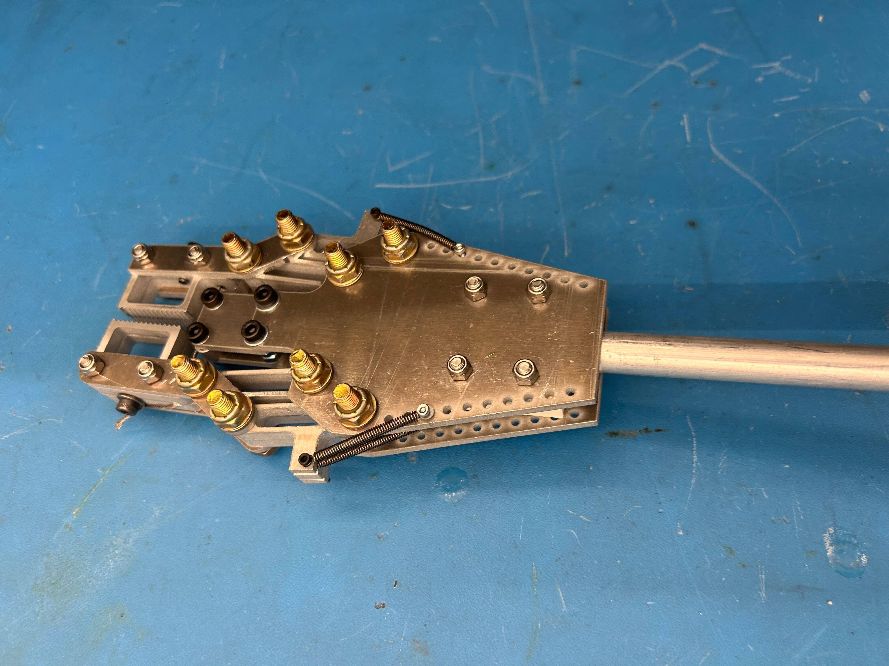
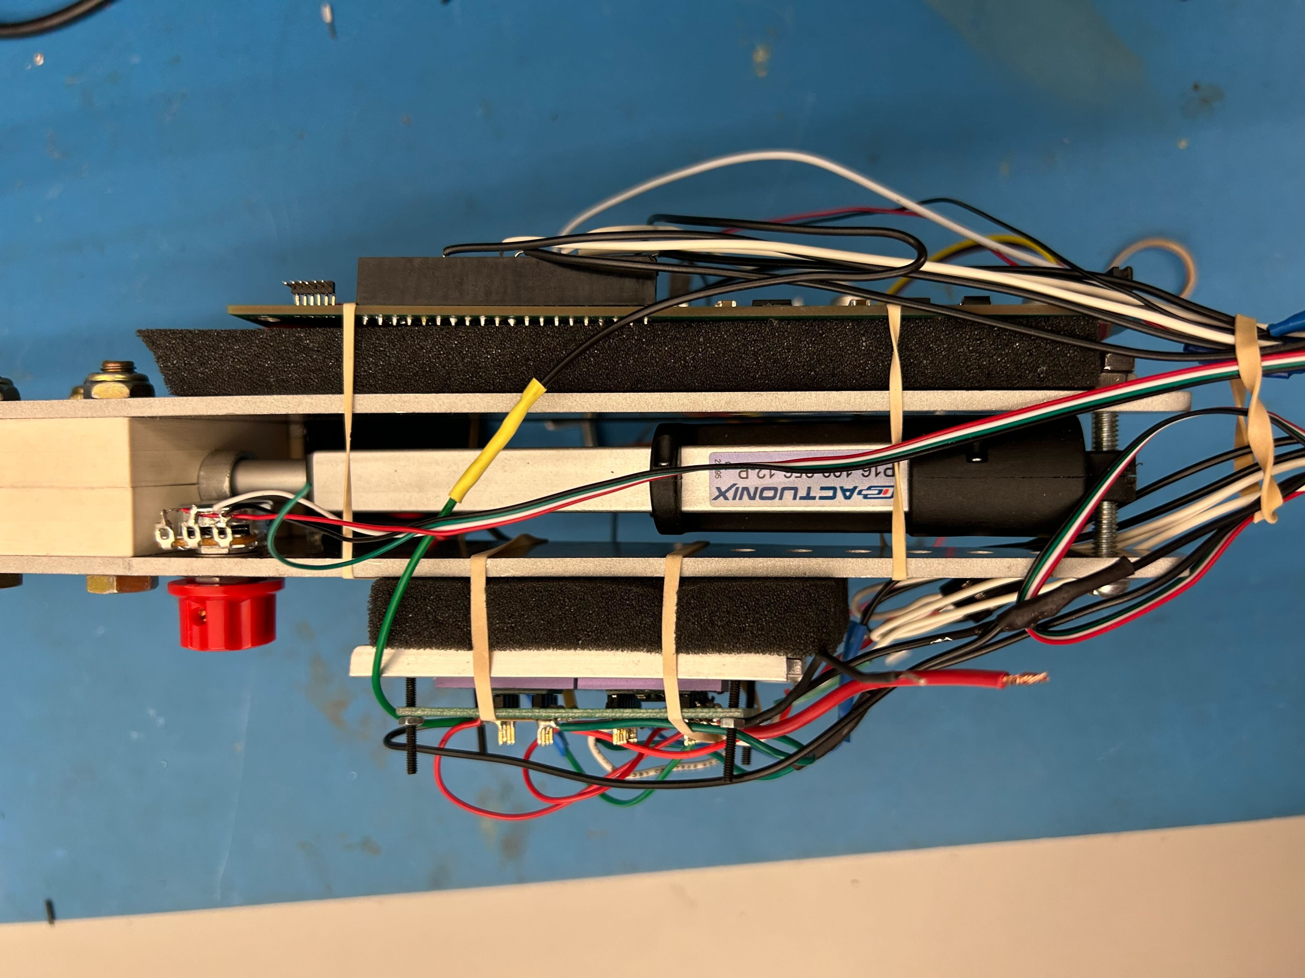
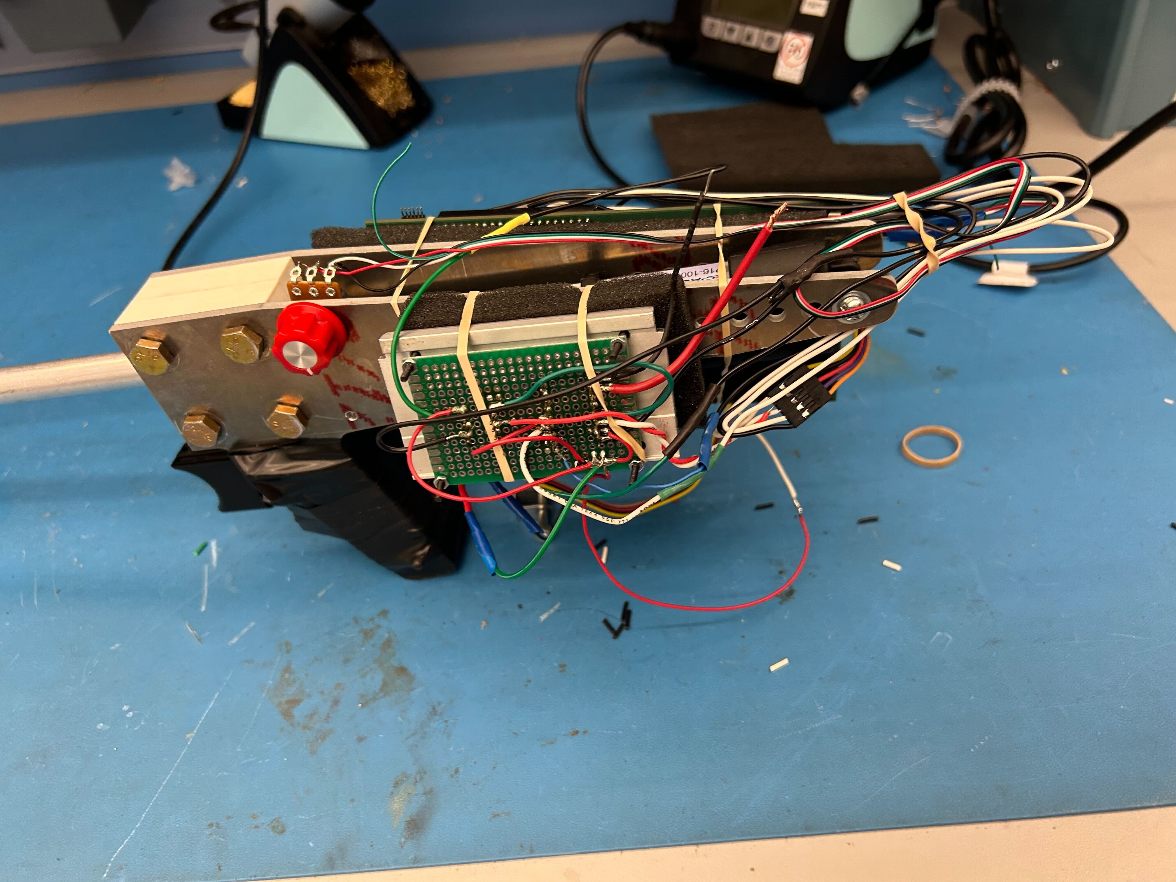

Summary
Impedance control end-effector via current control
4-bar linkage gripper geometry
Internal cable-driven gripper transmission, spring return
Actuator: Actuonix P16-P
12V, 1A (Continuous)
300N max continuous force
Potentiometer position feedback
Potentiometer Knob force “setting” control
Trigger-switch engagement

Slide 4
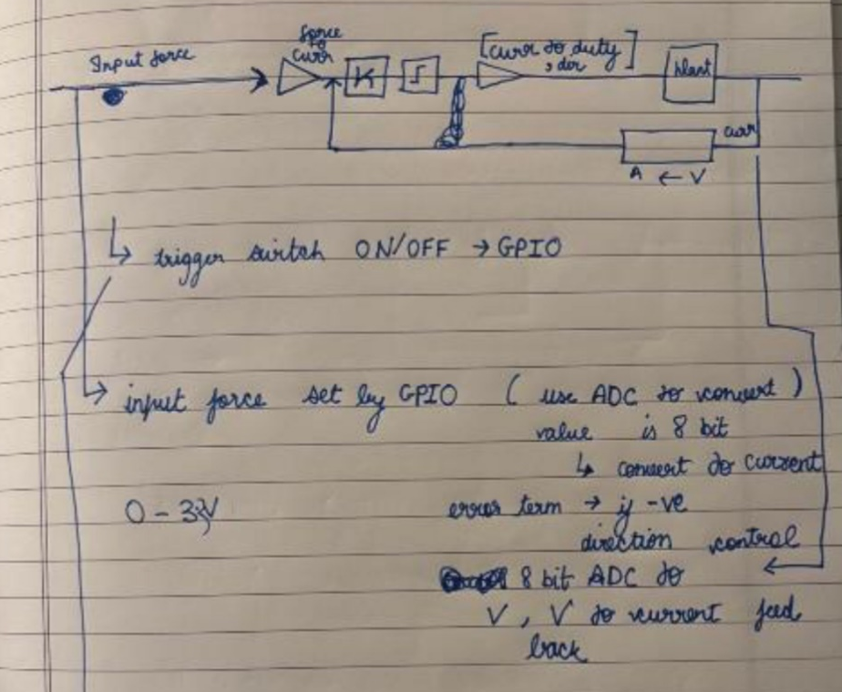
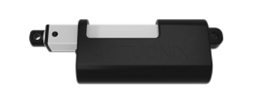
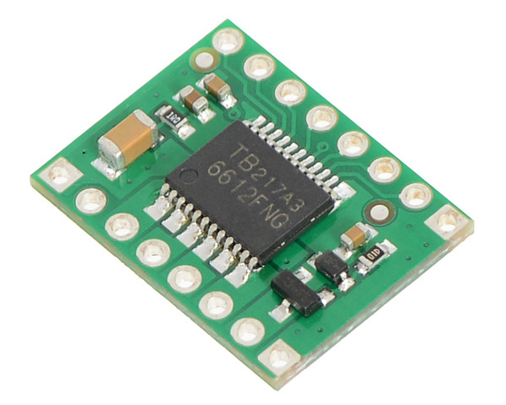
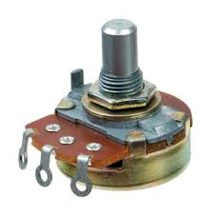
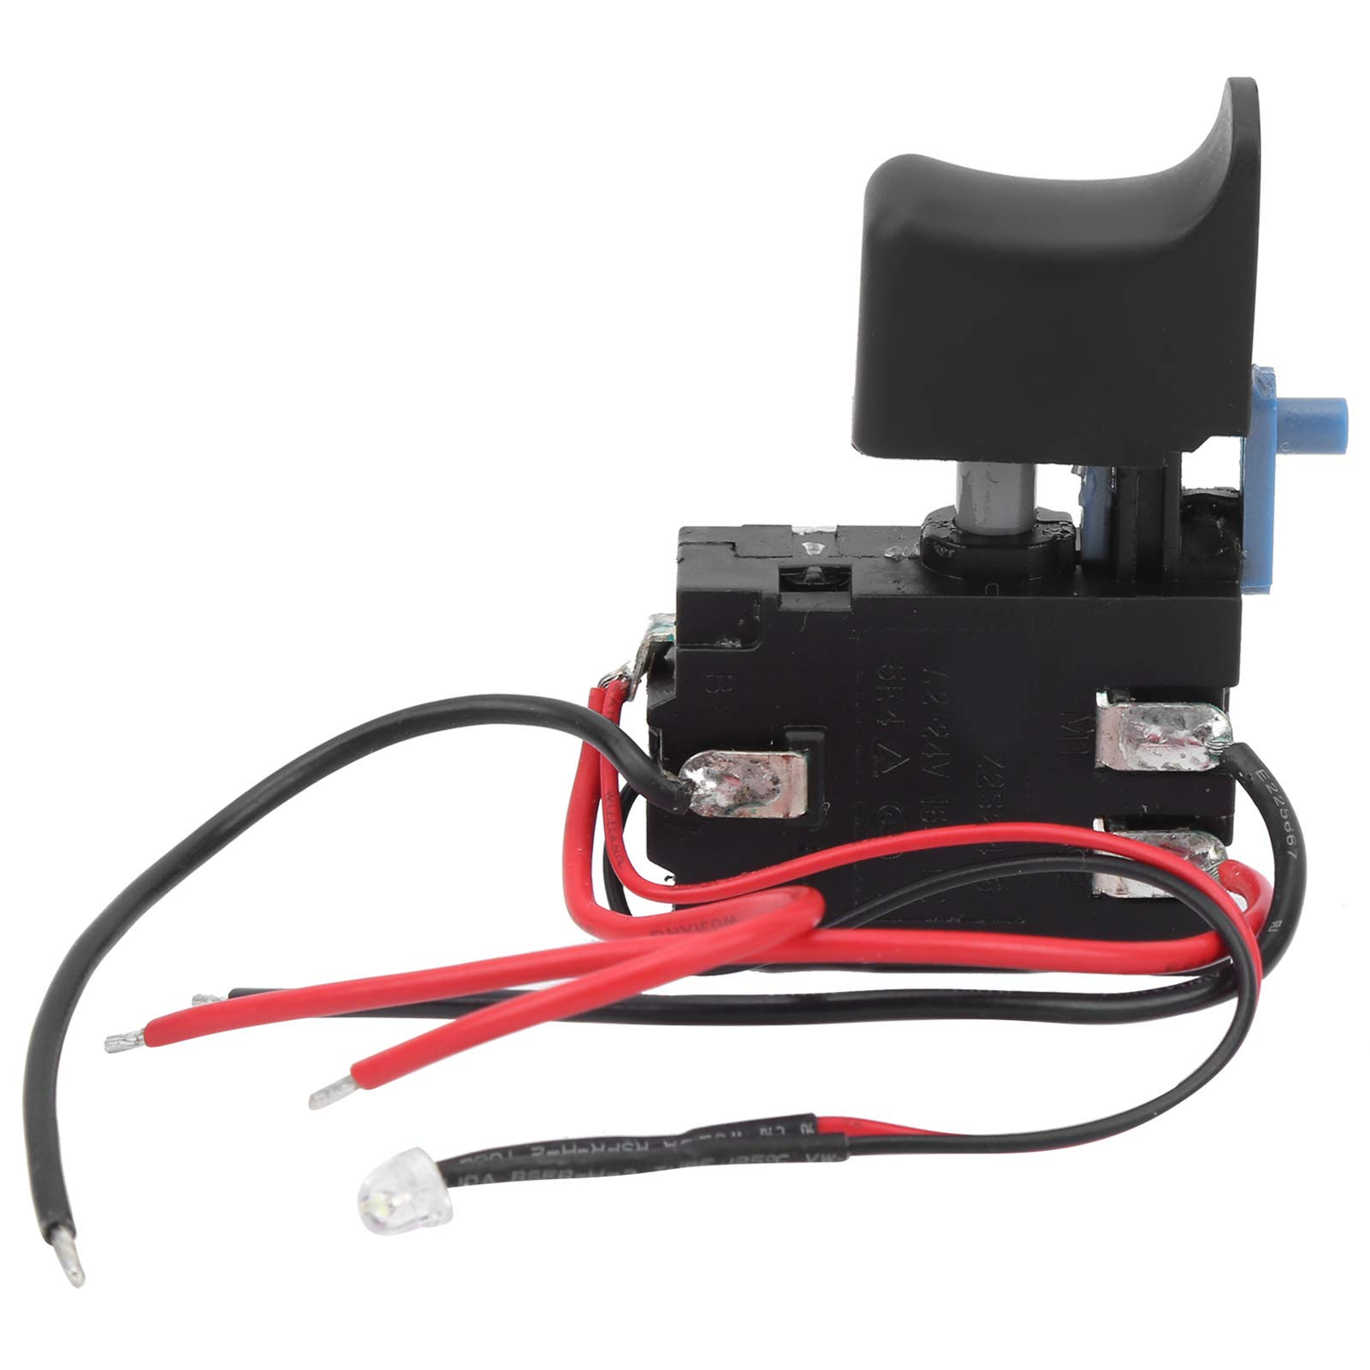
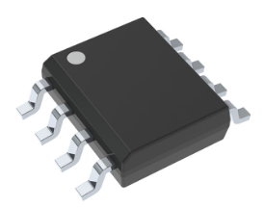
Control
Actuator closed-loop current feedback control
External pinching force-to-current correlation
Force/current setpoint controlled by user-input potentiometer
Actuator current reading with hall sensor
TMCS1107A4BQDRQ1
Hall Sensor
TB6612FNG Dual Motor Driver Carrier
Actuonix P16-P
(256:1)
Potentiometer
Trigger Switch

Slide 5
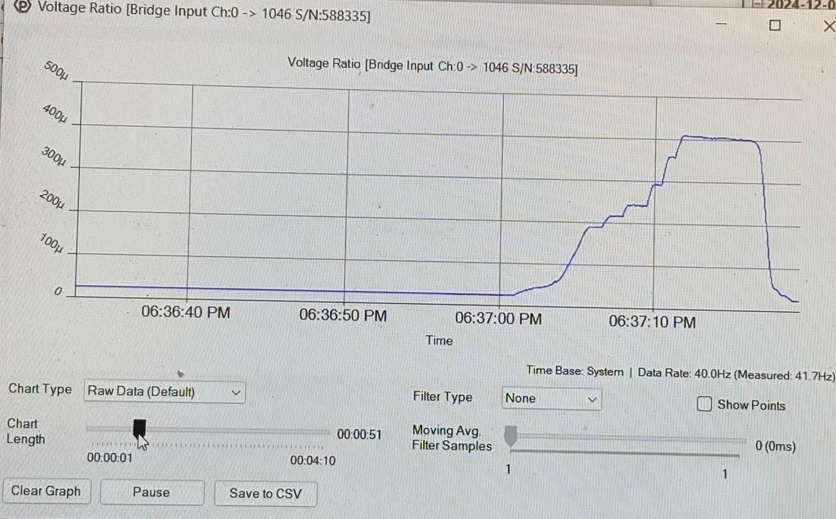
Results
Max Load: 150N Max Pinching Force
Min Load: 10N Min (controllable) pinching force
Impedance Control in gripping action but not releasing action
Difficult to back-drive
Weak return springs
Very high internal gear reduction (256:1)
Relatively high-friction internal leadscrew/nut

Slide 6
Improvements
Velocity or position control under no-load then switch to impedance control when excess current is sensed
Back-drivable or double-acting mechanism to allow for force control in both gripping and releasing
Remove the need for return springs that reduce max force output of the gripper

